Slide 1
Agenda
Session | Time | Presenter
Overcoming Scheduling Challenges for Exascale Workflows | 8:30AM – 8:50AM | Dong H. Ahn
Flux APIs for Scientific Workflows | 8:50AM – 9:20AM | Stephen Herbein
Real-World Practices and Examples | 9:20AM – 10:20AM | Joe Koning (30 mins) and Stephen Herbein (20 mins)
Break | 10:20AM – 10:30AM
Future topics: Resource data models and performance variation-aware scheduling | 10:30AM – 11:00AM | Dong H. Ahn and Tapasya Patki
Practical Considerations of using Flux and hands-on | 11:00AM – 12:00PM | Tapasya Patki + Stephen Herbein hands-on workflow examples

Slide 2
Flux: Using Next-Generation Resource Management and Scheduling Infrastructure for Exascale Workflows
Tutorial for the 2019 ECP Annual Meeting, Jan 16, 2019
Dong H. Ahn, Ned Bass, Albert Chu, Jim Garlick, Mark Grondona, Stephen Herbein, Joseph Koning, Tapasya Patki, Thomas R. W. Scogland, Becky Springmeyer, and Michela Taufer

Slide 3
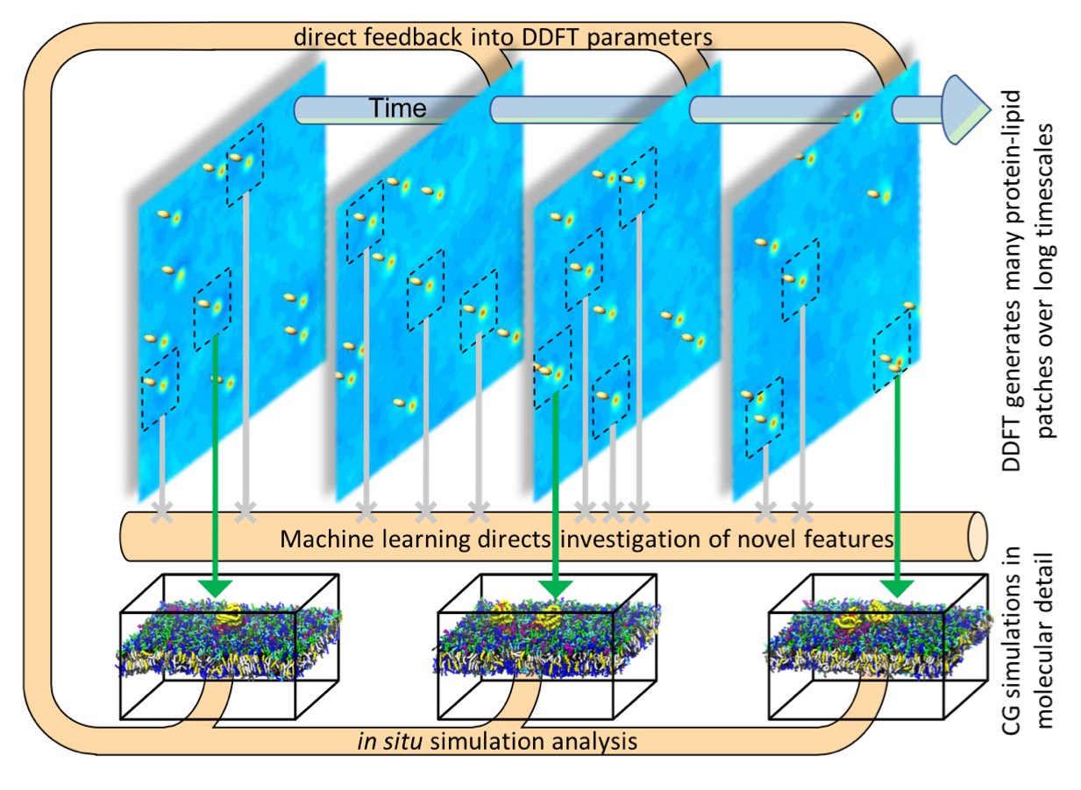
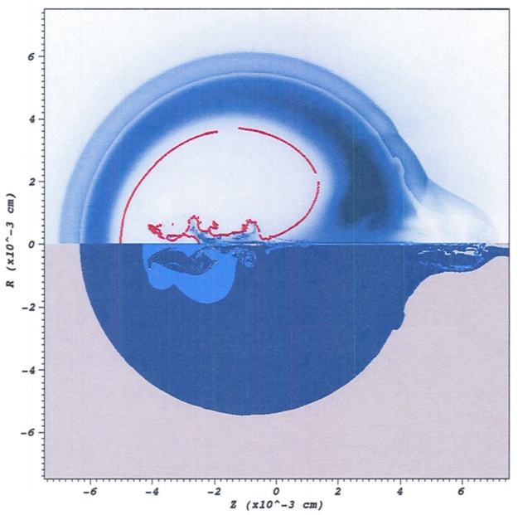

Workflows on high-end HPC systems are undergoing significant changes.
New pillar
Machine learning to compare
simulation and experiment
Traditional pillar
high-performance computing
Improved prediction
Deep neural network
HYDRA simulation
NIF X-ray image
Complete simulation and experiment data
Cancer Moonshot Pilot2 – co-schedule many elements and ML continuously schedules, de-schedules and executes MD jobs.
In-situ analytics modules
~7,500 jobs simultaneously running
Machine Learning Strategic Initiative (MLSI) – 1 billion short-running jobs!
Similar needs for co-scheduling heterogenous components

Slide 4

Key challenges in emerging workflow scheduling include…
New pillar
Co-scheduling challenge
Job throughput challenge
Job communication/coordination challenge
Portability challenge

Slide 5
Flux provides a new scheduling model to meet these challenges.
Allocated Resources
Flux Instance
Depth-1
Node
Node
Node
Node
Flux Instance
Flux Instance
Flux Instance
Flux Instance
Depth-2
C
C
C
C
C
C
C
C
C
C
C
C
C
C
C
C
C
C
C
C
C
C
C
C
C
C
C
C
C
C
C
C
Depth-3
C
C
C
C
C
C
C
C
C
C
C
C
C
C
C
C
C
C
C
C
C
C
C
C
C
C
C
C
C
C
C
C
Our “Fully Hierarchical Scheduling” is designed to cope with many
emerging workload challenges.

Slide 6
Flux is specifically designed to embody our fully hierarchical scheduling model.
Techniques
Challenges
Job Queue
Co-scheduling challenge
Job throughput challenge
Job communication/coordination challenge
Portability challenge
A
B
C
D
E
F…
Scheduler Specialization
Scheduler Parallelism
Rich API set
Consistent API set
Flux framework

Slide 7
Scheduler specialization solves the co-scheduling challenge.
Traditional approach
A single site-wide policy being enforced for all jobs
No support for user-level scheduling with distinct policies
Flux enables both system- and user-level scheduling under the same common infrastructure.
Give users the freedom to adapt their scheduler instance to their needs.
Instance owners can choose predefined policies different from system-level policies.
FCFS/backfilling
Scheduling parameters (queue depth, reservation depth etc)
Create their own policy plug-in

Slide 8
Scheduler parallelism solves the throughput challenge.
The centralized model is fundamentally limited.
Hierarchical design facilitates scheduler parallelism.
Deepening the scheduler hierarchy allows for higher levels of scheduler parallelism
Implementation used in our scalability evaluation:
Submit each job in the ensemble individually to the root
The jobs are distributed automatically across the hierarchy.

Slide 9
A rich API set enables easy job coordination and communication.
Jobs in ensemble-based simulations often require close coordination and communication with the scheduler as well as among them.
Traditional CLI-based approach is too slow and cumbersome.
Ad hoc approaches (e.g., many empty files) can lead to many side-effects.
Flux provides well-known communication primitives.
Pub/sub, request-reply, and send-recv patterns
High-level services
Key-value store (KVS) API
Job status/control (JSC) API
KZ stdout/stderr stream API

Slide 10
A consistent API set facilitates high portability.
Flux’s APIs are consistent across different platforms
Effort for porting and optimizing Flux itself for a new environment is small
Linux
Require the lower-level system to provide the Process Management Interface (PMI)

Slide 11
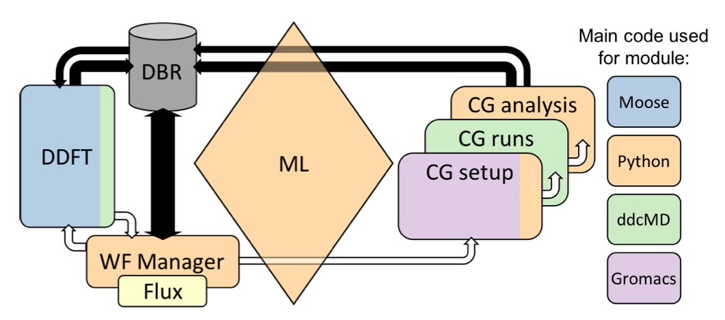
Scheduler specialization addresses co-scheduling challenges in Cancer Moonshot Pilot2 on Sierra
The machine-learning module evaluates the top n candidate patches for MD simulations.
Integrate Flux into Maestro workflow manager to start and stop jobs accordingly
Maestro adapter to Flux handles the volume of jobs and co-scheduling
At least 5 different logically separate jobs, each with CPU and/or GPU requirements on every node
Scheduling policy specialized to fastest FCFS policy (queue-depth=1) for throughput.
Use of a large single Flux instance
Pilot2 workflow architecture

Slide 12

Flux allows MLSI’s Merlin workflow manager for easy, scalable interaction with the scheduler.
Merlin manages the running of an ensemble of simulations with in-situ machine learning.
Divide up the large sample space into chunks to run a subset of simulations on each allocation.
Issues encountered in Merlin
Merlin worker runs on every node of the batch job allocation.
A simple python-based subprocess maps the number of tasks and resources onto the different system launch commands: portability and maintenance issues.
LSF jsrun does not allow Merlin brokers to call jsrun for simulations.
co-scheduling with heterogeneous CPUs and GPUs requirements
New pillar
Machine Learning Strategic Initiative

Slide 13
Flux helps Merlin with all of the key challenges.
A Flux instance is instantiated on each batch job allocation.
Replace python subprocess call with Flux’s python binding (rpc_send with a job.submit) to submit the job into the containing Flux instance.
The workflow manager can be informed on all stages of the job submission by registering a JSC callback on each status change of the submitted job.
Use of many small to medium-sized Flux instances for higher job throughput and resiliency.

Slide 14
Deepening scheduler hierarchy can significantly improve job throughput.
Depth-1: allocation level scheduler only
Depth-2: spawns additional node-level schedulers
Depth-3: further spawns core-level schedulers
Stress test
UQ workflow

Slide 15
Flux significantly enables emerging workflows on high-end HPC systems.
Ensemble-, coupling-based workflows are increasingly becoming a “norm” on high-end HPC systems and traditional approaches are hard-pressed.
Four key challenges have been identified.
Flux provides a new scheduling model and an implementation and API set that embody this model.
Our case studies and performance evaluations suggest that our model can significantly address all of the challenges.
Flux is powering up the production runs of the major science runs on LLNL’s Sierra, pre-exascale system.

Slide 16
Resources
flux-core:https://github.com/flux-framework/flux-core
flux-sched: https://github.com/flux-framework/flux-sched
Fully hierarchical scheduler: https://github.com/flux-framework/flux-hierarchy
Workflow examples: https://github.com/flux-framework/flux-workflow-examples
Quick guide: https://github.com/flux-framework/flux-framework.github.io

Slide 17
Disclaimer
This document was prepared as an account of work sponsored by an agency of the United States government. Neither the United States government nor Lawrence Livermore National Security, LLC, nor any of their employees makes any warranty, expressed or implied, or assumes any legal liability or responsibility for the accuracy, completeness, or usefulness of any information, apparatus, product, or process disclosed, or represents that its use would not infringe privately owned rights. Reference herein to any specific commercial product, process, or service by trade name, trademark, manufacturer, or otherwise does not necessarily constitute or imply its endorsement, recommendation, or favoring by the United States government or Lawrence Livermore National Security, LLC. The views and opinions of authors expressed herein do not necessarily state or reflect those of the United States government or Lawrence Livermore National Security, LLC, and shall not be used for advertising or product endorsement purposes.

Slide 18
Flux APIs for Scientific Workflows
Dong H. Ahn, Stephen Herbein, Joe Koning, Tapasya Patki, Tom Scogland
January 16, 2019

Slide 19
What is Flux?
New Resource and Job Management Software (RJMS) developed at LLNL
A way to manage remote resources and execute tasks on them

Slide 20


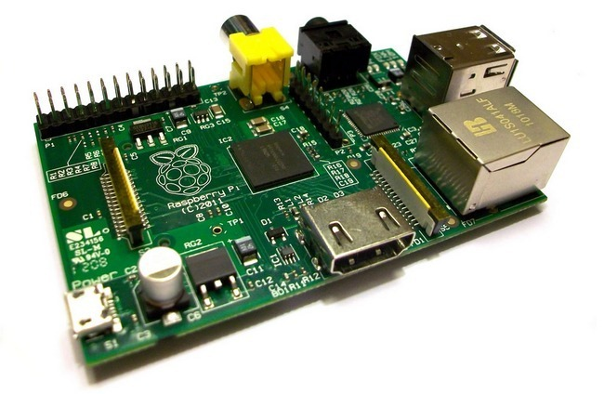

What is Flux?
New Resource and Job Management Software (RJMS) developed at LLNL
A way to manage remote resources and execute tasks on them
flickr: dannychamoro

Slide 21





What is Flux?
New Resource and Job Management Software (RJMS) developed at LLNL
A way to manage remote resources and execute tasks on them

Slide 22
Why Flux?
Extensibility
Open source
Modular design with support for user plugins
Scalability
Designed from the ground up for exascale and beyond
Already tested at 1000s of nodes & millions of jobs
Usability
C, Lua, and Python bindings that expose 100% of Flux’s functionality
Can be used as a single-user tool or a system scheduler
Portability
Optimized for HPC and runs in Cloud and Grid settings too
Runs on any set of Linux machines: only requires a list of IP addresses or PMI
Flux is designed to make hard scheduling problems easy

Slide 23
Portability: Running Flux
Already installed on TOSS systems (including Sierra)
spack install flux-sched for everywhere else
Flux can run anywhere that MPI can run, (via PMI – Process Management Interface)
Inside a resource allocation from: itself (hierarchical Flux), Slurm, Moab, PBS, LSF, etc
flux start OR srun flux start
Flux can run anywhere that supports TCP and you have the IP addresses
flux broker -Sboot.method=config -Sboot.config_file=boot.conf
boot.conf:
session-id = "mycluster"
tbon-endpoints = [
"tcp://192.168.1.1:8020",
"tcp://192.168.1.2:8020",
"tcp://192.168.1.3:8020"]

Slide 24
Why Flux?
Extensibility
Open source
Modular design with support for user plugins
Scalability
Designed from the ground up for exascale and beyond
Already tested at 1000s of nodes & millions of jobs
Usability
C, Lua, and Python bindings that expose 100% of Flux’s functionality
Can be used as a single-user tool or a system scheduler
Portability
Optimized for HPC and runs in Cloud and Grid settings too
Runs on any set of Linux machines: only requires a list of IP addresses or PMI

Slide 25
Usability: Submitting a Batch Job
Slurm
sbatch –N2 –n4 –t 2:00 sleep 120
Flux CLI
flux submit –N2 –n4 –t 2m sleep 120
Flux API:
import json, flux
jobreq = {
'nnodes' : 2,
'ntasks' : 4,
'walltime' : 120,
'cmdline' : ["sleep", "120"]}
f = flux.Flux ()
resp = f.rpc_send ("job.submit", json.dumps(jobreq))

Slide 26
Usability: Running an Interactive Job
Slurm
srun –N2 –n4 –t 2:00 sleep 120
Flux CLI
flux wreckrun –N2 –n4 –t 2m sleep 120
Flux API:
import sys
from flux import kz
resp = f.rpc_send ("job.submit", json.dumps(jobreq))
kvs_dir = resp['kvs_dir']
for task_id in range(jobreq['ntasks']):
kz.attach (f, "{}.{}.stdout".format(kvs_dir, task_id), sys.stdout)
f.reactor_run (f.get_reactor (), 0)

Slide 27
Usability: Tracking Job Status
CLI: slow, non-programmatic, inconvenient to parse
watch squeue –j JOBID
watch flux wreck ls JOBID
Tracking via the filesystem
date > $JOBID.start; srun myApp; date > $JOBID.stop
Push notification via Flux’s Job Status and Control (JSC):
def jsc_cb (jcbstr, arg, errnum):
jcb = json.loads (jcbstr)
jobid = jcb['jobid']
state = jsc.job_num2state (jcb[jsc.JSC_STATE_PAIR][jsc.JSC_STATE_PAIR_NSTATE])
print "flux.jsc: job", jobid, "changed its state to ", state
jsc.notify_status (f, jsc_cb, None)
Non-I/O
→ quota -vf ~/quota.conf
Disk quotas for herbein1:
Filesystem used quota limit files
/p/lscratchrza 760.3G n/a n/a 8.6M
I/O
Runtime Stages
I/O

Slide 28
Why Flux?
Extensibility
Open source
Modular design with support for user plugins
Scalability
Designed from the ground up for exascale and beyond
Already tested at 1000s of nodes & millions of jobs
Usability
C, Lua, and Python bindings that expose 100% of Flux’s functionality
Can be used as a single-user tool or a system scheduler
Portability
Optimized for HPC and runs in Cloud and Grid settings too
Runs on any set of Linux machines: only requires a list of IP addresses or PMI

Slide 29
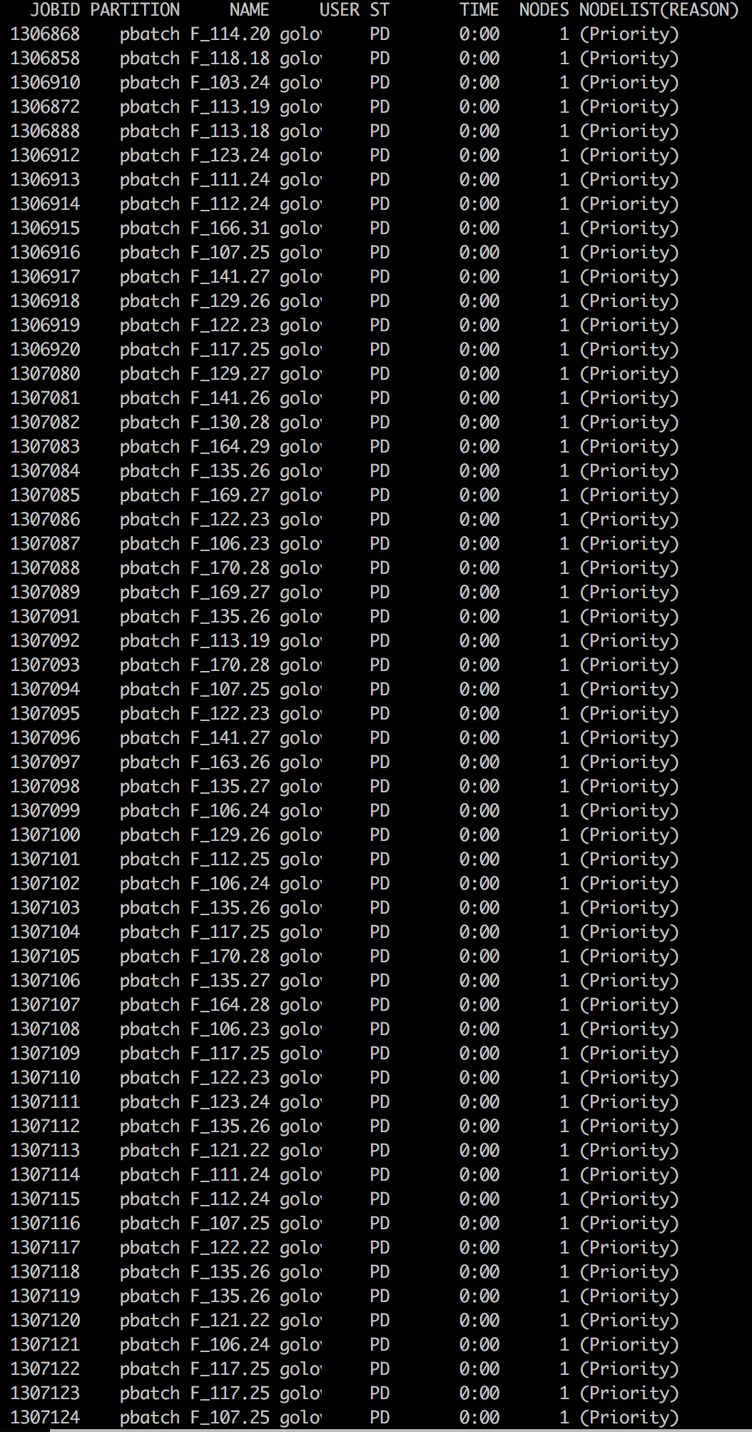
Scalability: Running Many Jobs
Slurm
find ./ -exec sbatch –N1 tar –cf {}.tgz {}\;
Slow: requires acquiring a lock in Slurm, can timeout causing failures
Inefficient: uses 1 node for each task
find ./ -exec srun –n1 tar –cf {}.tgz {}\;
Slow: spawns a process for every submission
Inefficient: is not a true scheduler – can overlap tasks on cores
Flux Capacitor
find ./ -printf -n1 tar –cf %p.tgz %p | flux-capacitor
flux-capacitor --command_file my_command_file
-n1 tar -cf dirA.tgz ./dirA
-n1 tar -cf dirB.tgz ./dirB
-n1 tar -cf dirC.tgz ./dirC
Flux API:
for f in os.listdir(‘.’):
payload[‘command’] = [“tar”, “-cf”, ”{}.tgz”.format(f), f]
resp = f.rpc_send ("job.submit", payload)
Subject: Good Neighbor Policy You currently have 271 jobs in the batch system on lamoab. The good neighbor policy is that users keep their maximum submitted job count at a maximum of 200 or less. Please try to restrict yourself to this limit in the future. Thank you.
Capacitor
Scheduler
Variable Input Job Stream
Constant Output Job Stream

Slide 30
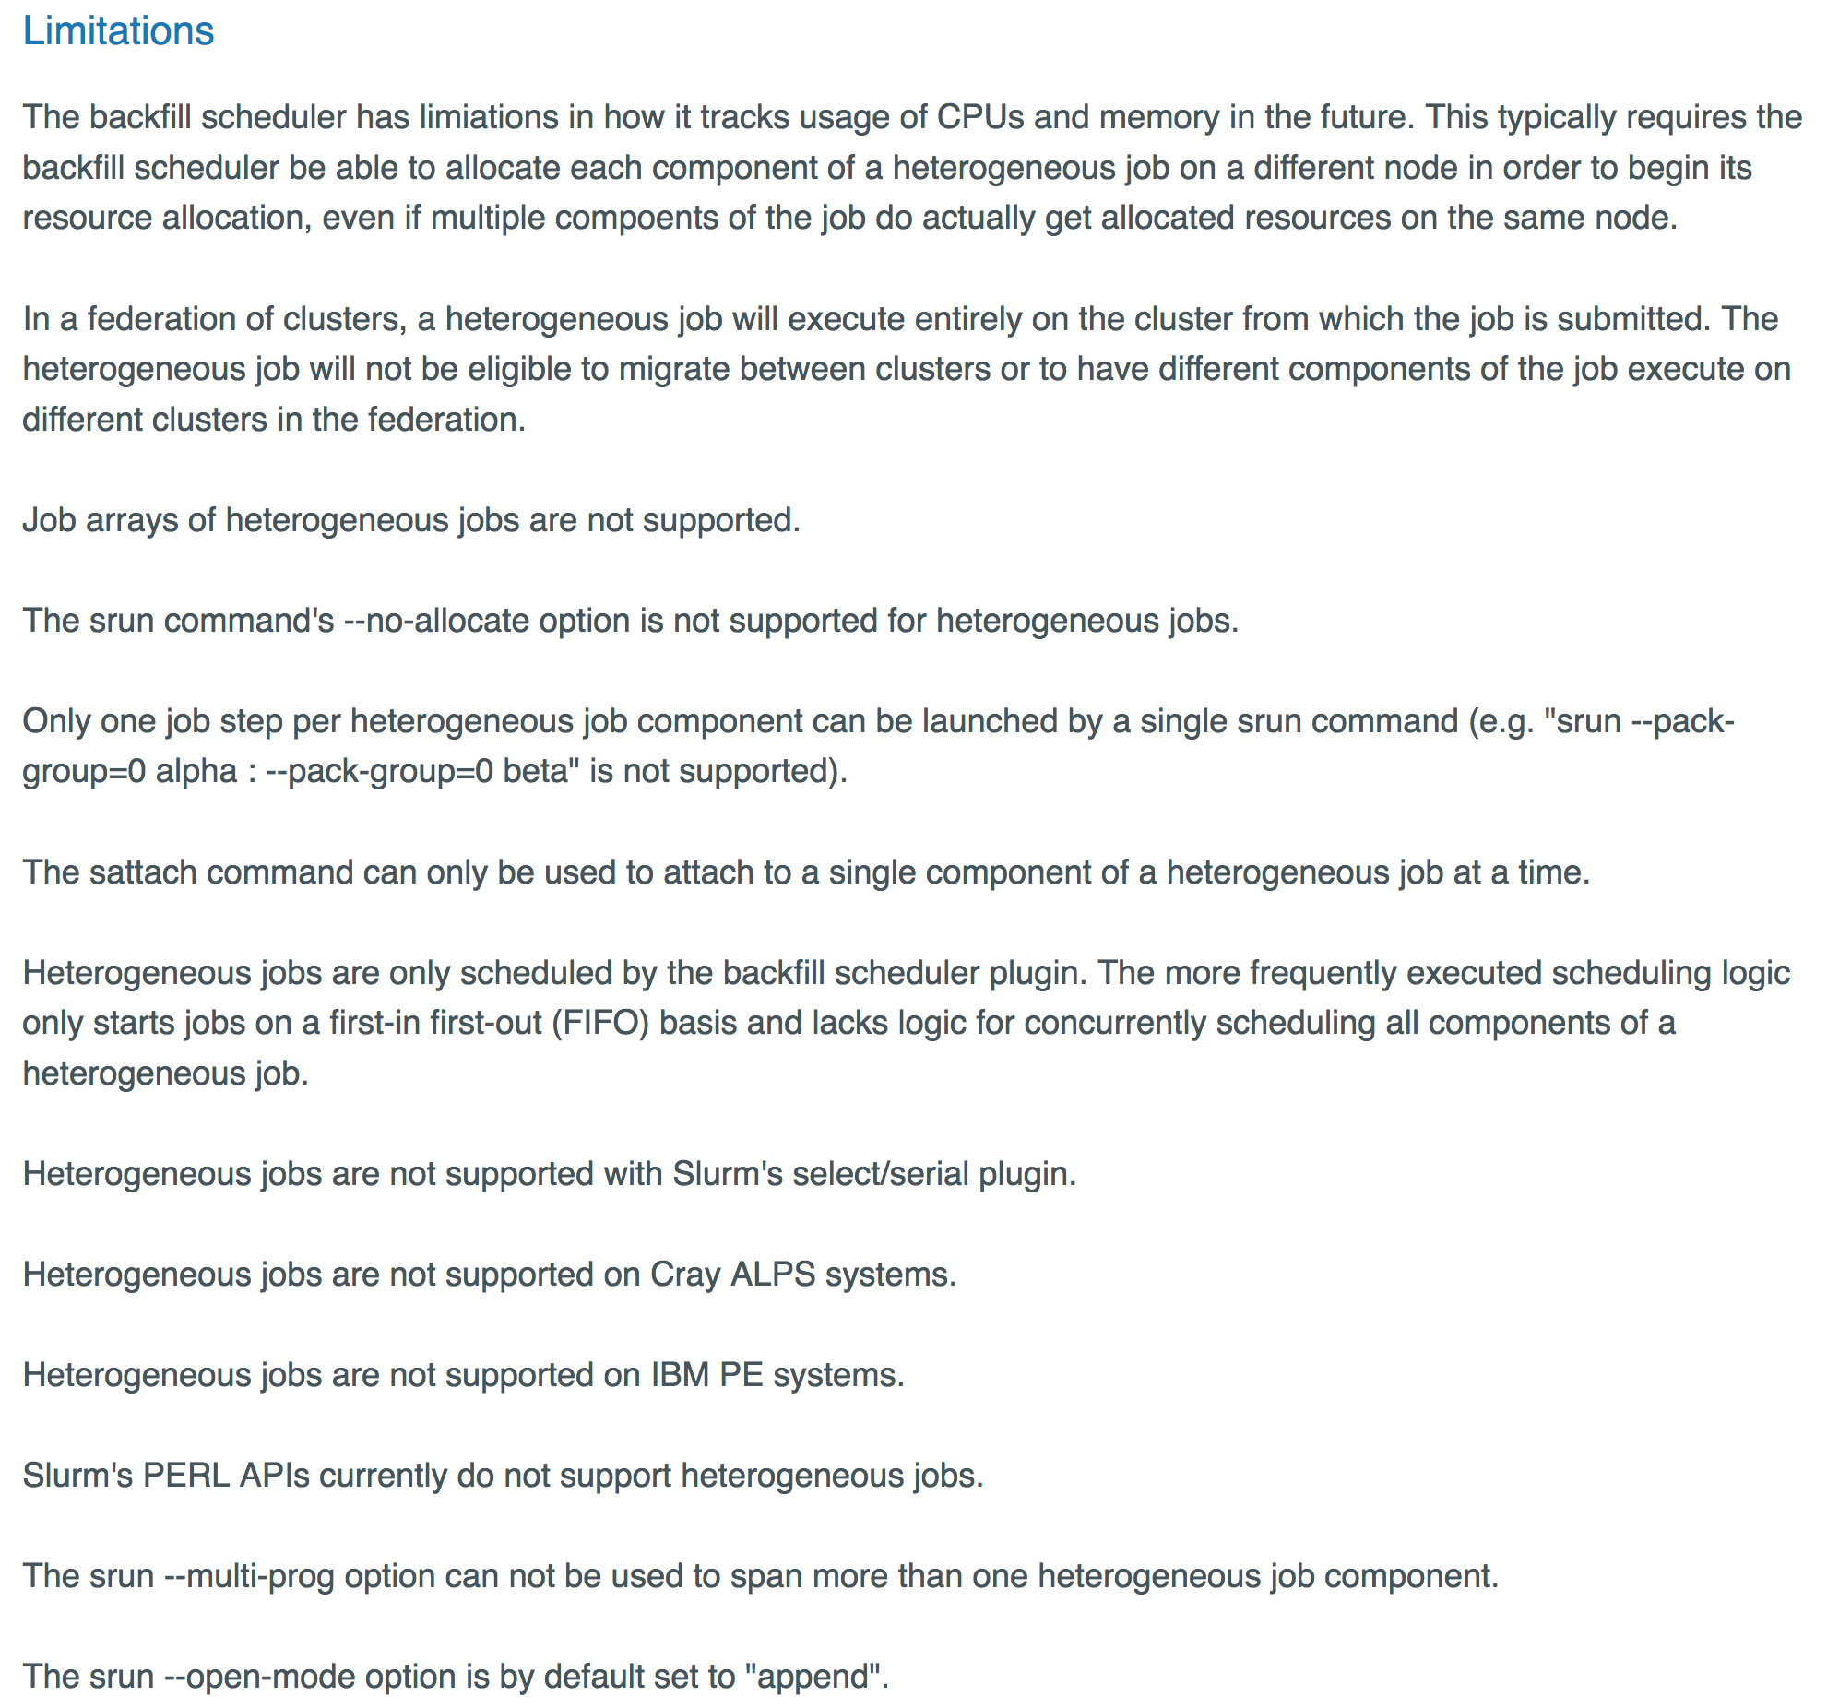
Scalability: Running Many Heterogeneous Jobs
Slurm
No support for heterogeneous job steps in versions before 17.11
Limited support in versions after 17.11
Flux Capacitor
flux-capacitor --command_file my_command_file
-n1 tar -cf dirA.tgz ./dirA
-n32 make –j 32
-N4 my_mpi_app
...
https://slurm.schedmd.com/heterogeneous_jobs.html#limitations

Slide 31
Scalability: Running Millions of Jobs
Flux Capacitor (Depth-1)
flux-capacitor --command_file my_command_file
Hierarchical Flux Capacitor (Depth-2)
for x in ./*.commands; do flux submit -N1 flux start \ flux-capacitor --command_file $x done
Flux Hierarchy (Depth-3+)
flux-hierarchy --config=config.json --command_file my_command_file
Capacitor
Capacitor

Slide 32
Why Flux?
Extensibility
Open source
Modular design with support for user plugins
Scalability
Designed from the ground up for exascale and beyond
Already tested at 1000s of nodes & millions of jobs
Usability
C, Lua, and Python bindings that expose 100% of Flux’s functionality
Can be used as a single-user tool or a system scheduler
Portability
Optimized for HPC and runs in Cloud and Grid settings too
Runs on any set of Linux machines: only requires a list of IP addresses or PMI

Slide 33

Extensibility: Modular Design
At the core of Flux is an overlay network
Built on top of ZeroMQ
Supports RPCs, Pub/Sub, Push/Pull, etc
Modules provide extended functionality (i.e., services)
User-built modules are loadable too
Some modules also support plugins
External tools and commands can access services
User authentication and roles supported
Flux Instance
Service Modules
Heartbeat
Key-Value Store
Overlay Networks & Routing
Resource
Remote Execution
Msg Idioms (RPC/Pub-Sub)
Sched Framework
Comms Message Broker
Policy
Plugin A
Commands
flux submit
flux-capacitor

Slide 34
Extensibility: Creating Your Own Module
Register a new service “pymod.new_job” that ingests jobs and responds with a Job ID
Load using flux module load pymod --module=path/to/file.py
import itertools, json, flux
def handle_new_job(f, typemask, message, arg):
job_queue, job_ids = arg
job_queue.append(message.payload)
response = {‘jobid’ : job_ids.next()}
f.respond(message, 0, json.dumps(response))
def mod_main(f, *argv):
f.msg_watcher_create(flux.FLUX_MSGTYPE_REQUEST,
handle_new_job,"pymod.new_job", args=([], itertools.count(0))).start()
f.reactor_run(f.get_reactor(), 0)

Slide 35
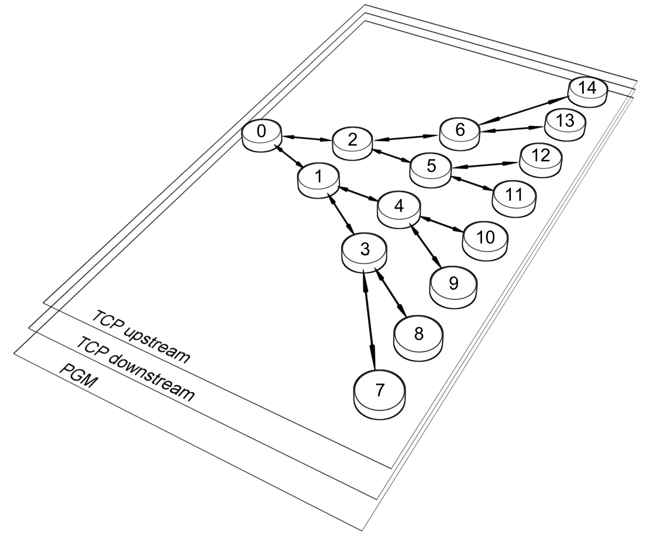
Extensibility: Flux’s Communication Overlay
Connect to a running flux instance
f = flux.Flux()
Send an RPC to a service and receive a response
resp = f.rpc_send (”pymod.new_job", payload) jobid = json.loads(resp)[‘jobid’]
Subscribe to and publish an event
f.event_subscribe(“node_down”) f.msg_watcher_create(node_down_cb, raw.FLUX_MSGTYPE_EVENT, “node_down”).start()
f.event_send(“node_down”)

Slide 36
Extensibility: Scheduler Plugins
Common, built-in scheduler plugins:
First-come First-Served (FCFS)
Backfilling
Conservative
EASY
Hybrid
Various, advanced scheduler plugins:
I/O-aware
CPU performance variability aware
Network-aware
Create your own!
Loading the plugins
flux module load sched.io-aware
FLUX_SCHED_OPTS="plugin=sched.fcfs" flux start

Slide 37

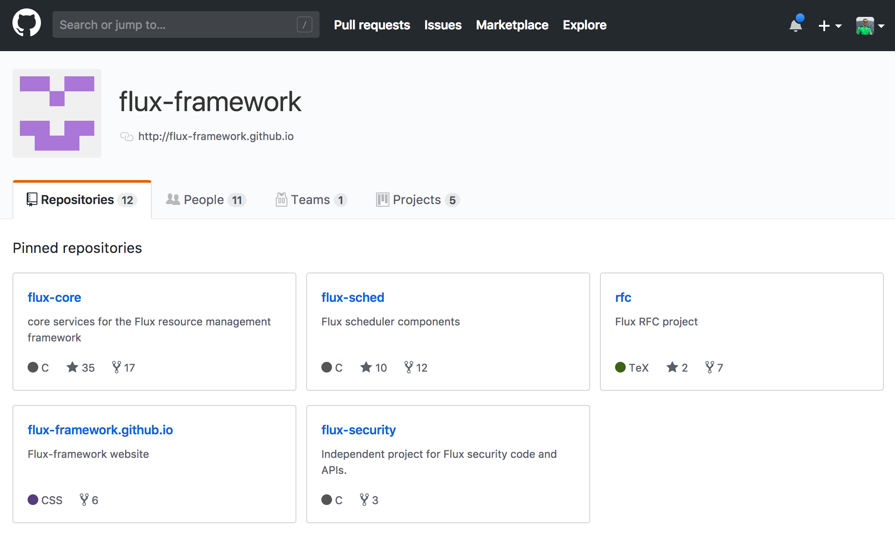
Extensibility: Open Source
Flux-Framework code is available on GitHub
Most project discussions happen in GitHub issues
PRs and collaboration welcome!
Thank You!

Slide 38
Disclaimer
This document was prepared as an account of work sponsored by an agency of the United States government. Neither the United States government nor Lawrence Livermore National Security, LLC, nor any of their employees makes any warranty, expressed or implied, or assumes any legal liability or responsibility for the accuracy, completeness, or usefulness of any information, apparatus, product, or process disclosed, or represents that its use would not infringe privately owned rights. Reference herein to any specific commercial product, process, or service by trade name, trademark, manufacturer, or otherwise does not necessarily constitute or imply its endorsement, recommendation, or favoring by the United States government or Lawrence Livermore National Security, LLC. The views and opinions of authors expressed herein do not necessarily state or reflect those of the United States government or Lawrence Livermore National Security, LLC, and shall not be used for advertising or product endorsement purposes.

Slide 39
Merlin Workflow Tutorial Featuring FLUX scheduling
ECP Meeting, Houston, TX
Jan 2019
Joseph Koning

Slide 40
The LLNL Machine Learning Strategic Initiative LDRD aims to add a third pillar to scientific discovery
Add a machine learning pillar to bridge the gap between simulation and experimental data
Brian Spears, LDRD PI
Luc Peterson, Workflow PI
Merlin is developed by: Luc Peterson, Peter Robinson, Jessica Semler, Benjamin Bay, John Field, Joe Koning
New pillar
Machine learning to compare
simulation and experiment
Traditional pillar
high-performance computing
Traditional pillar
Experimental Data
Improved prediction
Deep neural network
HYDRO simulation
NIF X-ray image
Complete simulation and experiment data

Slide 41
Merlin was created to handle the full workflow of an Ensemble of simulations
Provide for the ability to run an ensemble of data while learning and speculating with the learned model
Run a large ensemble of simulations from python to large multi-physics simulation codes
Machine Learning needs large amounts of data
Use machine learning to create a model of the data from the ensemble

Slide 42
The previous ensemble method was too rigid and did not allow for arbitrary tasks
Problem
An ensemble of simulations may consist of various components that do not run at the same time or on the same resources
This ensemble may consist of a large number of tasks that are intractable for a user to orchestrate themselves
The ensemble may change as it is being run
Tasks
Learn
RunSim
Train
Aggregate

Slide 43
Runtime issues and finite allocations can cripple productivity in large ensembles
Problems
Large Ensembles are more prone to issues with resources
Compute resource availability
Task crashes
Compute resource sharing (timeouts)
Data state is more difficult to assess

Slide 44
Implementing a scheduler to handle all the arbitrary tasks is challenging
Problem
Different tasks may need different resources
May need to write our own scheduler
The task based nature of the workflow means there will be nested launches (workers launched with jsrun calling jsrun)
Utilizing all the resources on the allocation is imperative

Slide 45
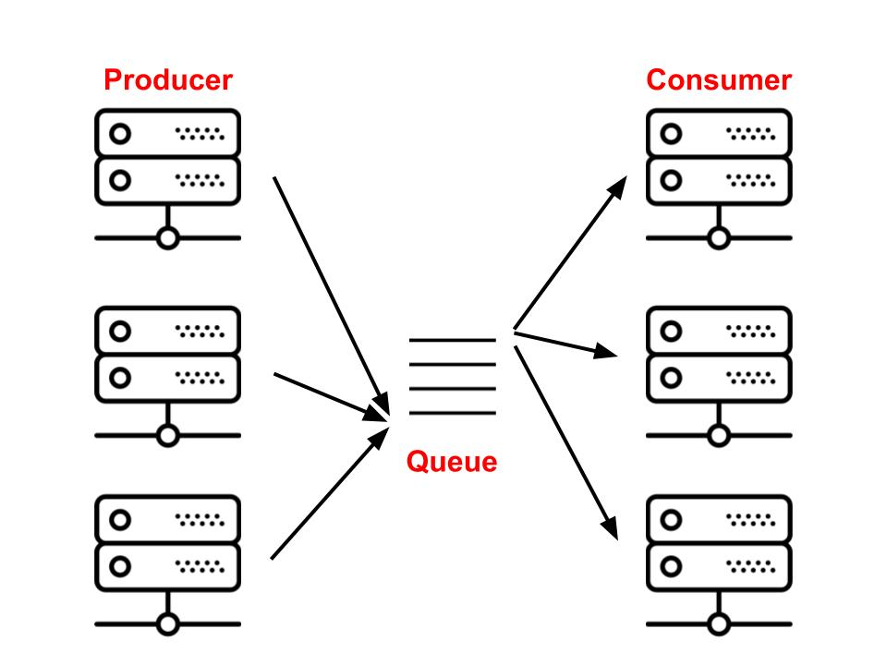
The celery system allows for arbitrary task definition
Solution
Celery provides a producer/consumer environment
A broker server will contain the tasks to be run
Workers (cluster compute resources) will request tasks , run them and return state and results
A backend server will collect the results

Slide 46

A server with state saving capability can alleviate issues with finite resources
Solution
The redis in memory key-value store can provide the broker and backend functionality while not requiring a dedicated server.
State can be written to files for compute resource restart
The server can be run on a dedicated machine or as part of the allocation

Slide 47

Flux allows for scheduling on any cluster
Solution
Provides a consistent API to launch jobs on all of the LLNL platforms (toss3, BlueOS, etc.)
Provides job state introspection to notify when each stage of job is reached
Caches run information in a node master key value store (kvs)
Can be queried while flux is live
Allows for scheduling/launch on heterogenous architectures. Some jobs on CPU and some on GPU for Sierra.

Slide 48
The Merlin Ensemble combines the executable, environment and configuration into celery tasks
The Merlin ensemble contains:
Configuration to run each simulation:
Environment
Resource request
Arguments
A set of variables and ranges combined into the sample set for the ensemble
Methods to convert the state into all necessary tasks including running, combining and saving the data
Several methods can be used to run tasks including python, shell, MPI (slurm, lsf) or Flux launched

Slide 49
Merlin Demo: Configuration definition
The celery app, ExexEnsemble and task definitions are imported from merlin and demo modules
The mpi configuration for a single task is then defined
1 #!/usr/bin/env python
2 import os
3 import sys
4 import numpy
5 from merlin.celery import app
6 from merlin.common.ensemble.ensemble import ExeEnsemble
7 from merlin.common.ensemble.sample_interface import FileSampleDescriptor, FileSampleGenerator
8 from hello_tasks import HelloTask
9 env = {}
10 flux = True
11 mpi_exe='hello.exe`'
12 mpi_exe_args={}
13 mpi=dict(mpi_tasks=1, mpi_nodes=1)
14 cfg = dict(
15 debug=True,
16 flux=flux,
17 env=env
18 )

Slide 50
Merlin Demo Task definition
The Task definition for the Hello example will run the Hello executable with a set of parameters
"""The Demo exe Tasks and executable."""
from __future__ import absolute_import
from merlin.common.ensemble.bundled_tasks import BundledTask
from merlin.common.executable import Executable
def runexe(**kwargs):
""" Get the exe executable, set the output_path for this
sample set and run. This is the function merlin will run.
"""
mexe = kwargs.pop('exe', None)
ret = mexe.start(**kwargs)
return ret
class HelloTask(BundledTask):
def __init__(self):
super(HelloTask, self).__init__(runHello, "hello")

Slide 51
Merlin Demo : Executable definition
The configuration for a single Executable is is created, this excutable will be given a sample set to run by the Ensemble
21 exe = Executable(mpi,mpi_exe,mpi_exe_args,**cfg)
22 params = dict(
23 parm1=[1.3, 1.3],
24 foo=[3.3, 3.3],
25 bar=[5.5, 5.5],
26 )
27
28 OUTPUT_DIR = os.path.join(runpath, 'EXE_OUTPUT_D')
29 DEFAULT_SAMPLES = 10
30 BUNDLE_SIZE = 1
31 DIRECTORY_SIZES = [4, 2]

Slide 52
Merlin Demo: Samples and Ensemble setup
The samples are written to a file from use by the Emsemble
The Emsemble and Executable are configured using the setup dict
33 # The number of samples to run with.
34 try:
35 print("Input {0}".format(sys.argv[1]))
36 nsamples = int(sys.argv[1])
37 except IndexError:
38 nsamples = DEFAULT_SAMPLES
39 filename = "exesamples.npy"
40 naxes = 8
41 numpy.save(filename, numpy.random.uniform(0., 1., (nsamples, naxes)))
42 my_sample_descriptor = FileSampleDescriptor(filename)
43 my_samples = FileSampleGenerator(my_sample_descriptor).generate()
44 # Workflow parameters and setup configurations.
45 setup = {
46 'samples': my_samples,
47 'outdir': OUTPUT_DIR,
48 'bundle_size': BUNDLE_SIZE,
49 'directory_sizes': DIRECTORY_SIZES,
50 'archive_path': ARCHIVE_DIR,
51 'exe': mpi_exe,
52 'parameters': params
53 }

Slide 53
Merlin Demo: Ensemble definition and run
The ExeEmsemble contains the methods to launch the job and the specific task that will be run and the methods for creating the sample list
The Ensemble is then run and waits for all tasks to complete before archiving the results
54 ensemble = ExeEnsemble('Demo Ensemble','Demo’, HelloTask, **setup)
55 print ("Queueing tasks...")
56 ensemble.setup()
57 print ("waiting for tasks (worker needs to be live for this to return)\n"
58 "This test assumes the worker has access to same file system as\n"
59 "this test")
60 ensemble.run()
61 ensemble.waitAll()
62 ensemble.printStats()
63
64 print ("archiving")
65 ensemble.archive()

Slide 54
FluxExecutable: payload definition
The payload for the flux rpc request defines the variables necessary to launch the parallel job
105 def get_payload(self, eargs):
106 """Create the flux process payload which is the job description for a
107 single MPI instance of the executable.”””
108
109 compute_jobreq = {
110 'cmdline': args,
111 'ntasks': self.tasks,
112 'cwd': cwd,
113 'environ': cenv,
114 'walltime': self.walltime,
115 'ngpus': self.ngpus,
116 }
117
118 if self.nodes:
119 compute_jobreq['nnodes'] = self.nodes
120
121 if self.cores:
122 compute_jobreq['ncores'] = self.cores
123
124 return json.dumps(compute_jobreq)

Slide 55
FluxExecutable: Running the simulation with rpc calls
172 def run(self, eargs):
173 """Launch the Flux process of the exe and wait
174 for the return message.
175 """
176 # The flux module is provided by the flux environment.
177 # This environment isn't available until the task is run
178 # by the worker which is run under flux.
179 import flux
180 import flux.kvs as kvs # key,value store
181 from flux import jsc, kz # Job status and control and kvs zio interface
182 result = {}
183 # Create the flux handle, this is unpickleable
184 fh = flux.Flux()
185 # Register the callback in the local flux handle (fh)
186 # Send self through so the jobid can be read from self.jobid
187 # once it is known after the submission
188 jsc.notify_status(fh, FluxExecutable.jsc_cb, (fh, self))
189 payload = self.get_payload(eargs)
190 # Submit the job, this is async.
191 resp = fh.rpc_send("job.submit", payload)
192 self.jobid = resp['jobid']
193 kvs_path = resp['kvs_path']
194 rootstdout = StringIO()
195 kz.attach(fh, kvs_path + ".0.stdout", rootstdout)
196 # Call the reactor , the reactor will block until
197 # the callback stops it.
198 fh.reactor_run(fh.get_reactor(), 0)
199 # Get the job lwj from the flux kvs.
200 jobkvs = kvs.get_dir(fh, kvs_path)
201 jobkvskeys = jobkvs.keys()
202 if jobkvs['state'] == 'complete':
203 pass
204 return result
This run method will get the payload and submit the request then wait for one of the states defined in the jsc_cb to occur

Slide 56
FluxExecutable: job status and control callback
The job status and control (jsc) callback method will inform the celery task when the simulation enters the complete, cancelled or failed states
83 @staticmethod
84 def jsc_cb(jcbstr, args, errnum):
85 """ The job status and control callback.
86 This function will be called everytime a job known by
87 self.fh changes state.
88
89 Modified from flux-framework/flux-workflow-examples/example7,
90 by Dong Ahn.
91 """
92 from flux import jsc # Job status and control
93 f, the_self = args
94 jcb = json.loads(jcbstr)
95 jobid = jcb['jobid']
96 state = jsc.job_num2state(
97 jcb[jsc.JSC_STATE_PAIR][jsc.JSC_STATE_PAIR_NSTATE])
98 if the_self.debug:
99 print("flux.jsc: job", jobid, "changed its state to ", state)
100 print("flux.jsc: monitoring ", the_self.jobid)
101 states = ["complete", "cancelled", "failed"]
102 if jobid == the_self.jobid and state in states:
103 f.reactor_stop(f.get_reactor())

Slide 57
Running the Demo:
Create a redis server to provide the broker and backend service
Start flux and then celery workers using flux
Run the executable ensemble through the celery workers

Slide 58
Disclaimer
This document was prepared as an account of work sponsored by an agency of the United States government. Neither the United States government nor Lawrence Livermore National Security, LLC, nor any of their employees makes any warranty, expressed or implied, or assumes any legal liability or responsibility for the accuracy, completeness, or usefulness of any information, apparatus, product, or process disclosed, or represents that its use would not infringe privately owned rights. Reference herein to any specific commercial product, process, or service by trade name, trademark, manufacturer, or otherwise does not necessarily constitute or imply its endorsement, recommendation, or favoring by the United States government or Lawrence Livermore National Security, LLC. The views and opinions of authors expressed herein do not necessarily state or reflect those of the United States government or Lawrence Livermore National Security, LLC, and shall not be used for advertising or product endorsement purposes.

Slide 59
Flux: Real-World Practices and Examples – Part 2
Dong H. Ahn, Stephen Herbein, Joe Koning, Tapasya Patki, Tom Scogland
January 16, 2019

Slide 60
Pilot2 Workflow Overview
Cellular-scale continuum model simulates large spatial and temporal scales
Machine learning model selects novel patches to simulate in molecular detail
Microscale results fed back into macroscale

Slide 61
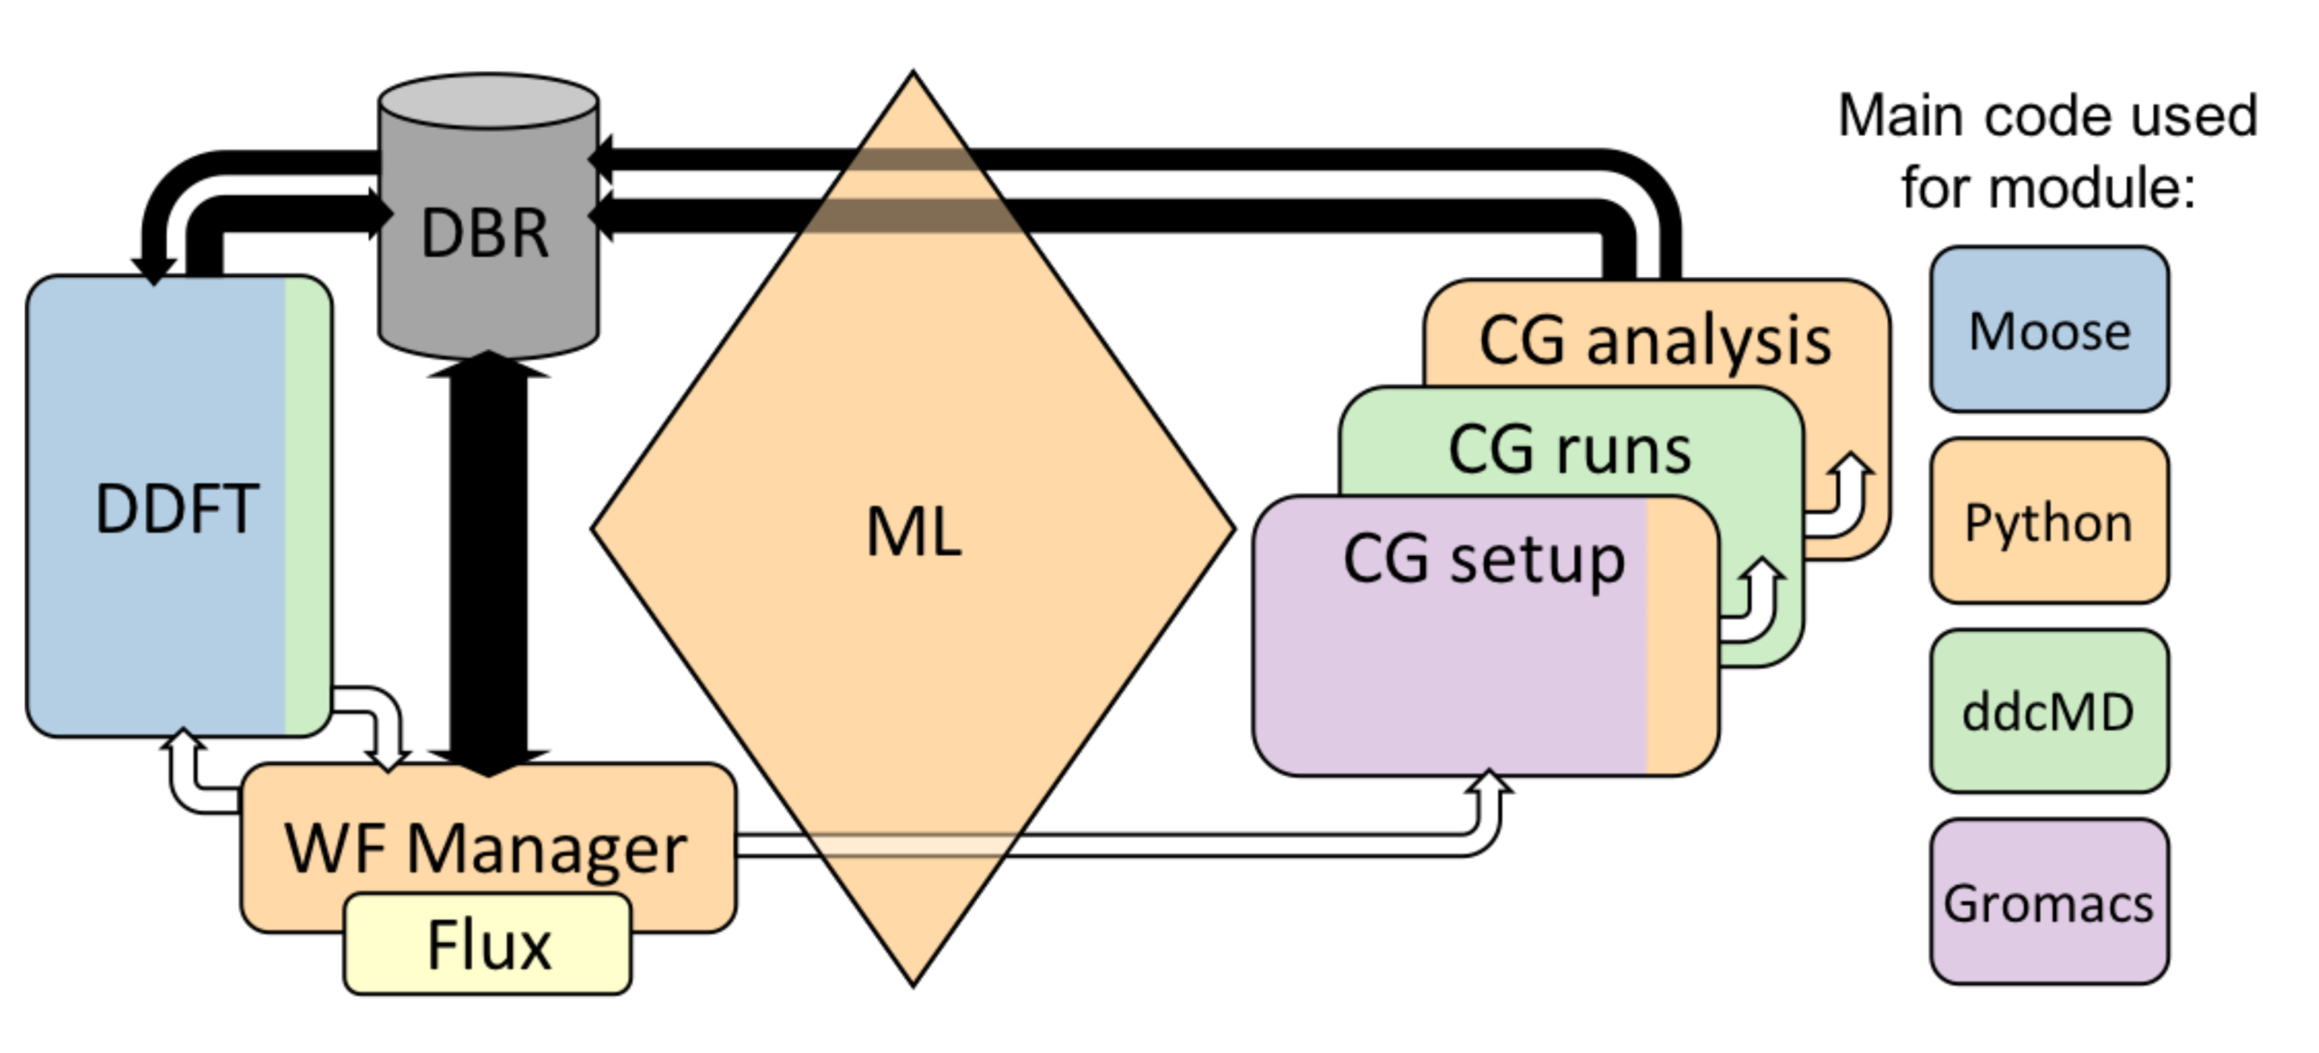
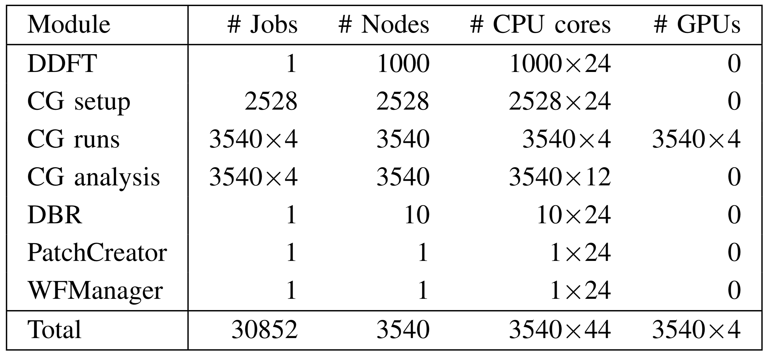
Pilot2 Scheduling Requirements
Many co-scheduled components, some are co-located
Each with their own unique resource requirements
8

Slide 62
Pilot2 Scheduling Requirements
Hardware
Jobs
Node
CG Analysis
Workflow Manager
Socket
CG Run
Patch Creator
CPU
CG Setup
Databroker
GPU
DDFT
Workflow Manager
Patch Creator
Databroker
DDFT Macro-Scale Simulation
CG Setup
CG Setup
CG Setup
CG Setup
CG Setup
CG Setup
CG Setup
CG Setup
CG Setup
CG Setup
CG Setup
CG Setup
CG Setup
CG Setup
CG Setup
CG Setup
CG Setup
CG Setup
CG Setup
CG Setup
Notes:
Double check on L2 statement by Tom

Slide 63





Automated Testing System (ATS) Overview
“CI for HPC”
Run regression and performance tests of MPI application that may require multiple cores
Test in the same environment (hardware and software) that is used for production runs
Generate nightly reports for developers
Useful for comparing performance when compilers or system software change

Slide 64
ATS Scheduling Requirements
Launch all tasks without oversubscribing cores
Minimize wall time of testing suite
Maximize resource utilization
Portable across multiple schedulers and resource managers
Count
Number of Cores
Notes:
Why using traditional jobstep doesn't work in this case
Portability: works on SLURM and LSF

Slide 65
ATS Scheduling Requirements
Traditional HPC Scheduler’s
Job Step Packing
Flux’s “Job Step” Packing
We saw 3x-10x speedups when using Flux

Slide 66
Disclaimer
This document was prepared as an account of work sponsored by an agency of the United States government. Neither the United States government nor Lawrence Livermore National Security, LLC, nor any of their employees makes any warranty, expressed or implied, or assumes any legal liability or responsibility for the accuracy, completeness, or usefulness of any information, apparatus, product, or process disclosed, or represents that its use would not infringe privately owned rights. Reference herein to any specific commercial product, process, or service by trade name, trademark, manufacturer, or otherwise does not necessarily constitute or imply its endorsement, recommendation, or favoring by the United States government or Lawrence Livermore National Security, LLC. The views and opinions of authors expressed herein do not necessarily state or reflect those of the United States government or Lawrence Livermore National Security, LLC, and shall not be used for advertising or product endorsement purposes.

Slide 67
Flux’s Resource Data Model and Performance Variation-Aware Scheduling
ECP Annual Meeting, Jan, 2018
Dong H. Ahn and Tapasya Patki

Slide 68
The changes in resource types are equally challenging.
Problems are not just confined to the workload/workflow challenge.
Resource types and their relationships are also becoming increasingly complex.
Much beyond compute nodes and cores...
GPGPUs
Burst buffers
I/O and network bandwidth
Network locality
Power
PFS BW Capacity

Slide 69
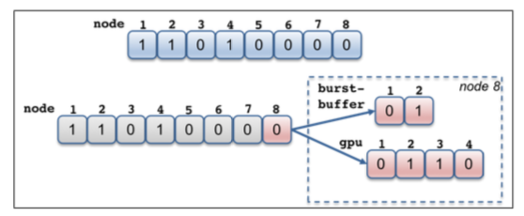
The traditional resource data models are largely ineffective to cope with the resource challenge.
Designed when the systems are much simpler
Node-centric models
SLURM: bitmaps to represent a set of compute nodes
PBSPro: a linked-list of nodes
HPC has become far more complex
Evolutionary approach to cope with the increased complexity
E.g., add auxiliary data structures on top of the node-centric data model
Can be quickly unwieldy
Every new resource type requires new a user-defined type
A new relationship requires a complex set of pointers cross-referencing different types.

Slide 70
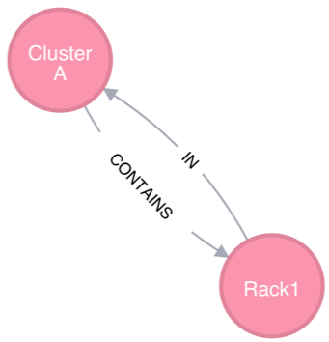
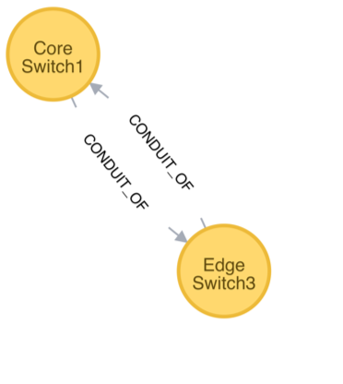
Flux uses a graph-based resource data model to represent schedulable resources and their relationships.
A graph consists of a set of vertices and edges
Vertex: a resource
Edge: a relationship between two resources
Containment subsystem
Network connectivity subsystem

Slide 71
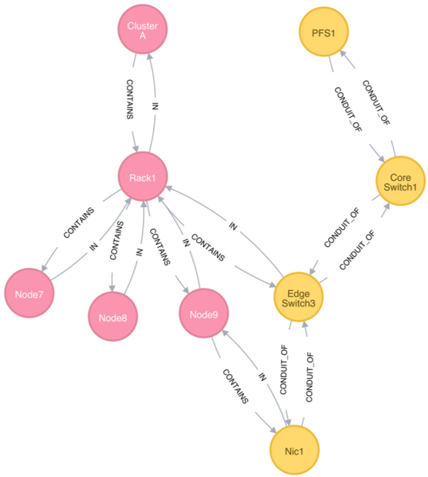
Our graph-based resource data model reduces the complexity of our scheduler.
Highly composable to support a graph with arbitrary complexity
Simply add new vertices and connectivity to compose
The scheduler remains to be a highly generic graph code.
No code change is required on new resource types and relationships.

Slide 72
Flux’s graph-oriented canonical job-spec allows for a highly expressive resource requests specification.
Graph-oriented resource requirements
Express the resource requirements of a program to the scheduler
Express program attributes such as arguments, run time, and task layout, to be considered by the execution service

Slide 73
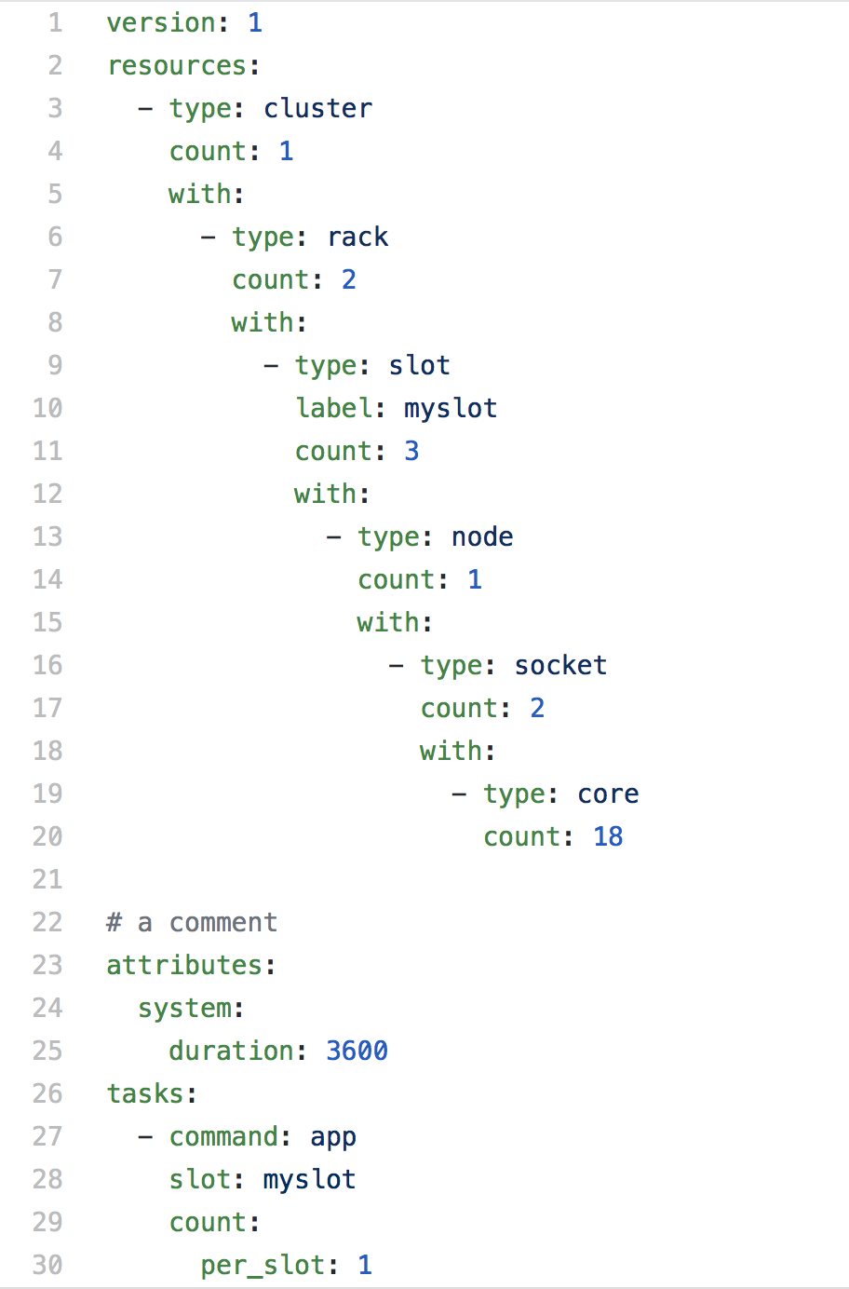
A jobspec example
YAML for human readability
End users will mostly use a more user-friendly notation
cluster->racks[2]->slot[3]->node[1]->sockets[2]->core[18]
slot is the only non-physical resource type
Represent a schedulable place where program process or processes will be spawned and contained
Referenced from the tasks section

Slide 74
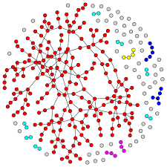
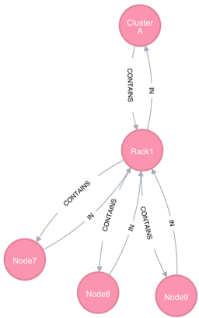
Flux maps our complex scheduling problems into graph matching problems.
Traverse, match and score

Slide 75
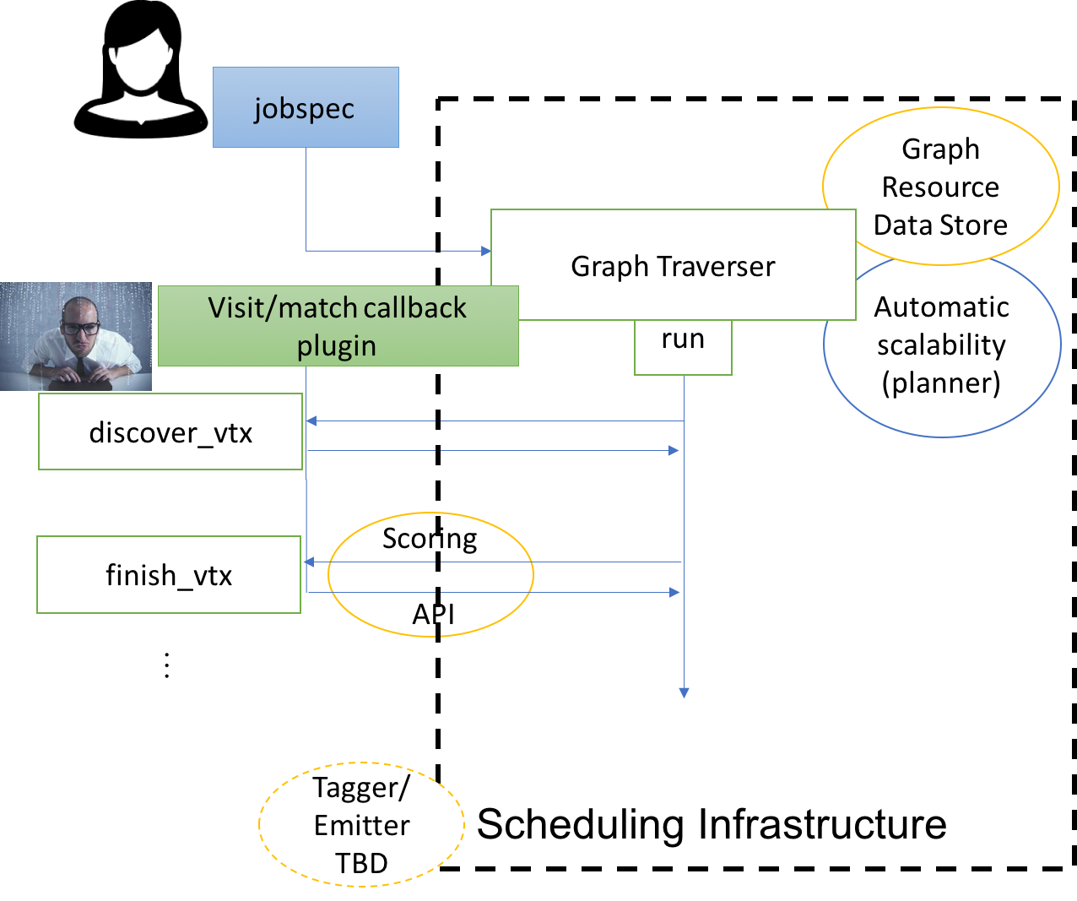
Our architecture embodies our graph matching scheme with good separation of concerns and extensibility.
Allow our resource module to populate and maintain the total graph of the instance.
Graph resource data store
On receiving each job-spec object:
Start to traverse the graph with a known visit type (currently DFV and DFU).
On each visit event (e.g., post-order visit)
a policy match callback is invoked to score the visiting vertex
high- or low-id first, locality-aware, and performance variation-aware policies
Best matching resources are selected at the end of the traversal.

Slide 76
We use graph filtering and pruned searching to manage the graph complexity and optimize our graph search.
The total graph can be quite complex
Two techniques to manage the graph complexity and scalability
Filtering reduces graph complexity
The graph model needs to support schedulers with different complexity
Provide a mechanism by which to filter the graph based on what subsystems to use
Pruned search increases scalability
Fast RB tree-based planner is used to implement a pruning filter per each vertex.
Pruning filter keeps track of summary information (e.g., aggregates) about subtree resources.
Scheduler-driven pruning filter update
Containment+Network
Containment
Filtering
Prune filter tracks available node count in aggregate at the subtree
Pruning

Slide 77
Overview
Problem:
Performance variation in applications
Worsening as we scale out
Potential solutions:
Advanced scheduling
Job-level runtime systems
Application-level load balancing
Our approach:
Use Flux’s flexible resource data model to design scheduling policies

Slide 78
Sources of variation
Deterministic sources
Based on hardware
Can be understood statically, are reproducible, can be predicted
Offline analysis is possible
Do not depend on dynamic user environments or job mix
Examples: component-level heterogeneity, processor manufacturing or aging
Non-deterministic sources
Not reproducible and cannot be understood statically
Depend on specific workloads, performance of neighboring jobs, current job mix, network or IO congestion, and user or system parameters
Online monitoring and runtime adjustment is required

Slide 79
Types of variation
Rank-to-rank variation
Occurs within the application resulting in unforeseen slowdowns and load imbalance
Application performance bound by slowest task
Run-to-run variation
Subsequent executions of the same application get vastly distinct allocations, lack reproducibility
First cut: Deterministic, rank-to-rank variation resulting from processor manufacturing variability in power-limited scenarios
Can be extended easily to other deterministic sources and for run-to-run variation (with or without power caps)

Slide 80
Real world example of variation: Quartz cluster, 2469 nodes, 50 W CPU power per socket
2.47x difference between the slowest and the fastest node for MG
1.91x difference for LULESH.

Slide 81
Statically determining node performance classes
Ranking every processor is not feasible from point of view of accounting as well as application differences
Statically create bins of processors with similar performance instead
Techniques for this can be simple or complex
How many classes to create, which benchmarks to use, which parameters to tweak
Our choice: 5 classes, LULESH and MG, 50 W power cap
Mitigation
Rank-to-rank: minimize spreading application across performance classes
Run-to-run: allocate nodes from same set performance classes to similar applications

Slide 82
Statically determining node performance classes: 2469 nodes of Quartz

Slide 83
Measuring impact of variation-aware scheduling
allocated(a,j) returns true if node a has been allocated to job j
P_{j} is the set of performance classes of the nodes allocated to job j
Figure of merit, fom_{j}, is a measure of how widely the job is spread across different performance classes
For a job trace, we will look for number of jobs with low figure of merit

Slide 84
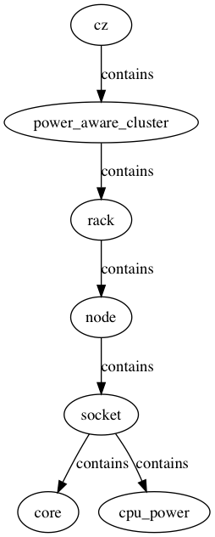
Implementation with Flux’s resource model: Resource graph, the layout of the cluster
Input format: graphml (GRUG)
Defined once when the cluster is brought up
Example resource graph with 4 nodes per rack, 2 sockets per node, 2 cores per socket and 1 unit of cpu_power (e.g. 100 W)
1
4
2
2
1

Slide 85
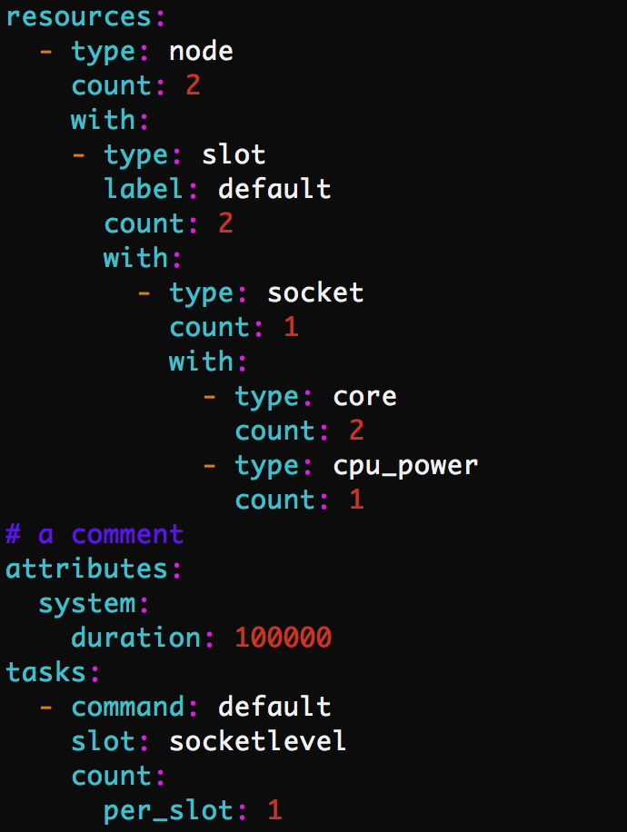
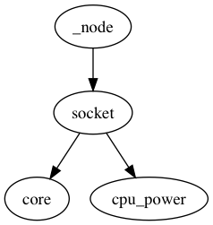
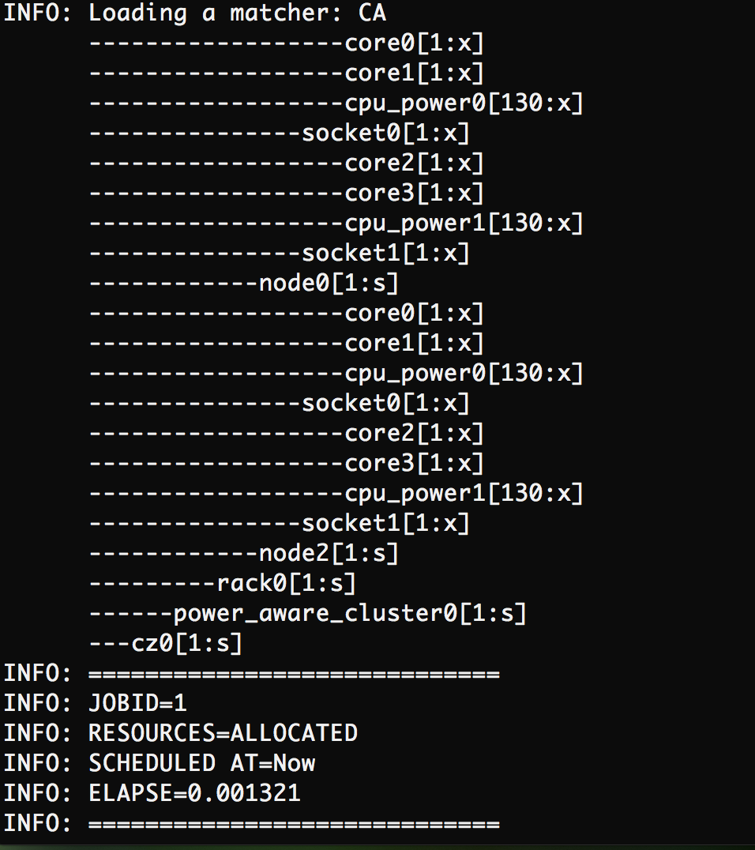
Flux’s resource-service: Users submit job requests, depth first traversal for matching
Resource Graph
Match root of job request with vertex in resource graph
Depth first traversal to allocate resources
Backtrack if resources are unavailable, and reserve for future
Example job request
2
2
1
2
1
4
2
2
1
Example output

Slide 86
Adding a new scheduling policy is simple, <250 LOC
Depth-first upwalk for graph matching
Implement by deriving from the base matcher callback class (dfu_match_cb_t) and by overriding one or more of its virtual methods.
The DFU traverser’s run() method calls back these methods on well-defined graph vertex visit events. Supported events:
Preorder, postorder, slot, and finishgraph events on the selected dominant subsystem
Preorder and postorder events on one or more selected auxiliary subsystems
Performance class information was captured through other headers
Can be specified as input CSV

Slide 87
Evaluation: Real job trace from Quartz cluster at LLNL
200 jobs captured as a trace from quartz cluster

Slide 88
Variation-aware scheduling results in 2.4x reduction in rank-to-rank variation in applications

Slide 89
Pruning intelligently can lead to good scaling and low overhead for the scheduling policy

Slide 90
Disclaimer
This document was prepared as an account of work sponsored by an agency of the United States government. Neither the United States government nor Lawrence Livermore National Security, LLC, nor any of their employees makes any warranty, expressed or implied, or assumes any legal liability or responsibility for the accuracy, completeness, or usefulness of any information, apparatus, product, or process disclosed, or represents that its use would not infringe privately owned rights. Reference herein to any specific commercial product, process, or service by trade name, trademark, manufacturer, or otherwise does not necessarily constitute or imply its endorsement, recommendation, or favoring by the United States government or Lawrence Livermore National Security, LLC. The views and opinions of authors expressed herein do not necessarily state or reflect those of the United States government or Lawrence Livermore National Security, LLC, and shall not be used for advertising or product endorsement purposes.

Slide 91
Flux Hands-on (Installing and Building)
Stephen Herbein and Tapasya Patki

Slide 92
Spack installation (for users who want to test Flux)
Install spack
git clone https://github.com/spack/spack.git
Setup spack
export SPACK_ROOT=/home/patki1/flux-tutorial/spack/
export PATH=$SPACK_ROOT/bin:$PATH
source $SPACK_ROOT/share/spack/setup-env.sh
Install flux-core and flux-sched
spack install flux-core@master
spack install flux-sched@master

Slide 93
Spack installation (for users who want to test Flux)
Install environment-modules for easy access (or lmod)
spack install environment-modules
source `spack location -i environment-modules`/Modules/init/bash*
Flux can now be loaded and unloaded as a module, spack sets correct paths
spack load flux-core@master
spack load flux-sched@master
$$ which flux
$$ /home/patki1/flux-tutorial/spack/opt/spack/linux-ubuntu18.04-x86_64/gcc-7.3.0/flux-core-master-5vtsnto3hbhllffc7g6nkht2at7r3hfp/bin/flux
spack unload flux-core@master
spack unload flux-sched@master
*Similar for tcsh or other shells

Slide 94
Installation from source (for developers)
redhat | ubuntu | version
autoconf | autoconf
automake | automake
libtool | libtool
libsodium-devel | libsodium-dev | >= 1.0.14
zeromq4-devel | libzmq3-dev | >= 4.0.4
czmq-devel | libczmq-dev | >= 3.0.1
jansson-devel | libjansson-dev | >= 2.6
lz4-devel | liblz4-dev
hwloc-devel | libhwloc-dev | >= v1.11, < 2.0
sqlite-devel | libsqlite3-dev | >= 3.0.0
yaml-cpp-devel | libyaml-cpp-dev | >= 0.5.1
lua | lua5.1 | >= 5.1, < 5.3
lua-devel | liblua5.1-dev | >= 5.1, < 5.3
lua-posix | lua-posix
python-devel | python-dev | >= 2.7
python-cffi | python-cffi | >= 1.1
python-six | python-six | >= 1.9
python-yaml | python-yaml | >= 3.10.0
python-jsonschema | python-jsonschema | >= 2.3.0
asciidoc | asciidoc
asciidoctor | asciidoctor | >= 1.5.7
aspell | aspell
valgrind | valgrind
mpich | mpich
Clone flux-core
https://github.com/flux-framework/flux-core.git
Install dependencies
If using ubuntu, the following may be needed:
sudo ln -s posix_c.so /usr/lib/x86_64-linux-gnu/lua/5.1/posix.so
./autogen.sh
./configure --prefix=<path-to>/flux-install/
make –j
make check
make install

Slide 95
Test flux-core installation (src/cmd/flux or <flux-install>/bin/flux )
$$ flux start --size=2
flux-start: warning: setting --bootstrap=selfpmi due to --size option
$$ flux wreckrun -n2 hostname
ip-172-31-23-210
ip-172-31-23-210
$$ flux wreck ls
ID NTASKS STATE START RUNTIME RANKS COMMAND/NAME
1 2 exited 2019-01-16T09:30:40 0.048s [0-1] hostname
$$ flux wreck status 1
Job 1 status: complete
task[0-1]: exited with exit code 0
$$ flux ping --count=2 kvs
kvs.ping pad=0 seq=0 time=0.421 ms (DADF8!511D5!0!0)
kvs.ping pad=0 seq=1 time=0.458 ms (DADF8!511D5!0!0)

Slide 96
Test flux-core installation
$$ flux module list
Module Size Digest Idle S Nodeset Service
connector-local 1144768 975A4C0 0 R 0
cron 1184136 E3E625C 0 S 0
aggregator 1116416 DE854F7 22 S 0
kvs 1619904 29F6823 0 S 0
kvs-watch 1338256 F404210 22 S 0
job 1172184 328022D 21 S 0
barrier 1095736 B182EDE 22 S 0
userdb 1097864 CA2C717 21 S 0
resource-hwloc 1121432 5F13ABB 21 S 0
content-sqlite 1105552 499411F 21 S 0 content-backing

Slide 97
Installation from source (for developers)
Clone flux-sched
https://github.com/flux-framework/flux-sched.git
Install flux-core, install dependencies
Export PKG_CONFIG_PATH
export PKG_CONFIG_PATH=<path-to>/flux-install/lib/pkgconfig:$PKG_CONFIG_PATH
./autogen.sh
./configure --prefix=<path-to>/flux-install/
make –j
make check && make install
libhwloc-dev >= 1.11.1 libboost packages == 1.53 or > 1.58
libboost-dev
libboost-system-dev
libboost-filesystem-dev
libboost-thread-dev
libboost-graph-dev
libboost-regex-dev
libxml2-dev >= 2.9.1

Slide 98
Test flux-sched installation
$$ flux start --size=2
$$ flux module load sched rdl-conf=$HOME/flux-tutorial/manual/flux-sched/conf/hype.lua plugin=sched.fcfs
flux-module: cmb.insmod[0]: sched module/service is in use
$$ flux module list
Module Size Digest Idle S Nodeset Service
connector-local 1144768 1CC5BCF 0 R 0
aggregator 1116416 89EF851 9 S 0
resource-hwloc 1121432 0D39236 9 S 0
barrier 1095736 F30D755 9 S 0
cron 1184136 0D39555 0 S 0
sched 582240 5F37621 8 S 0
job 1172184 3B9C4DD 9 S 0
content-sqlite 1105552 EFC59D8 9 S 0 content-backing
userdb 1097864 30E9BFD 9 S 0
kvs 1619904 D5EF875 0 S 0
resource 14410664 BD76156 8 S 0
kvs-watch 1338256 E654D34 9 S 0

Slide 99
Test flux-sched installation
$$ flux submit -n2 sleep 0
submit: Submitted jobid 1
$$ flux kvs dir lwj.0.0.1
lwj.0.0.1.0.
lwj.0.0.1.1.
lwj.0.0.1.R_lite = [{"children": {"core": "0-1"}, "node": "ip-172-31-23-210", "rank": 0}]
lwj.0.0.1.cmdline = ["sleep", "0"]
lwj.0.0.1.complete-time = 1547633240.881755
lwj.0.0.1.completing-time = 1547633240.879345
lwj.0.0.1.create-time = 1547633240.830361
lwj.0.0.1.cwd = /home/patki1/flux-tutorial/manual/flux-sched
lwj.0.0.1.environ = {"BASH_FUNC_spack%%": "() { if [ -n \"${ZSH_VERSION:-}\" ]; then\n emulate -L sh;\n fi;\n args=(\"$@\");\n _sp_flags=\"\";\n...
lwj.0.0.1.exit_status = {"count": 2, "entries": {"[0-1]": 0}, "max": 0, "min": 0, "total": 2}
lwj.0.0.1.files.
lwj.0.0.1.input.
lwj.0.0.1.ioservice = {"stderr": {"name": "596aa9984b841bcf:err", "rank": -1}, "stdout": {"name": "596aa9984b841bcf:out", "rank": -1}}
lwj.0.0.1.log.
lwj.0.0.1.ncores = 2
lwj.0.0.1.ngpus = 0
lwj.0.0.1.nnodes = 0
lwj.0.0.1.ntasks = 2
lwj.0.0.1.options = {"nokz": true}
lwj.0.0.1.opts.
lwj.0.0.1.output = {"files": {"stderr": "kvs://files.stderr", "stdout": "kvs://files.stdout"}}
lwj.0.0.1.pmi.
lwj.0.0.1.running-time = 1547633240.870165
lwj.0.0.1.starting-time = 1547633240.848241
lwj.0.0.1.state = complete
lwj.0.0.1.walltime = 0

Slide 101
Flux: Hands-on Workflow Examples
Dong H. Ahn, Stephen Herbein, Joe Koning, Tapasya Patki, Tom Scogland
January 16, 2019

Slide 102
Example 1: Partitioning vs Overlapping Scheduling
Partitioning Scheduling
Overlapping Scheduling
compute
compute
IO-forwarding
compute
compute
IO-forwarding

Slide 103
Example 7: Job Status & Control (JSC) API
Schedule and launch jobs
compute.py
bookkeeper.py
Submit jobs
Flux
Job Queue
compute
Job State Counters
Io-forward
Subscribe to job state changes
JSC
Submitted:
Notify subscriber of jobs completing
compute
IO_forwarding.py
4
Notify subscriber of jobs starting
0
4
Io-forward
2
Completed:
0
Jobs complete
Exit Condition Reached

Slide 104
Example 10: Data Conduit
Compute.lua
Datastore
Compute.lua
flux_open
flux_open
”conduit.put”:
{“data”: 1}
”conduit.put”:
{“data”: 3}
Flux Broker
Flux Initial Wireup
Flux Initial Wireup
Flux Broker
”conduit.put”:
{“data”: 1}
”conduit.put”:
{“data”: 3}
Unix Socket Create/Connect
Flux Broker
Flux Broker
”conduit.put”:
{“data”: 2}
”conduit.put”:
{“data”: 4}
Compute.lua
flux_open
Flux Broker
Compute.lua
Conduit
”conduit.put”:
{“data”: 4}
”conduit.put”:
{“data”: 2}
flux_open
Flux Initial Wireup
Flux Initial Wireup
flux_open

Slide 105
Disclaimer
This document was prepared as an account of work sponsored by an agency of the United States government. Neither the United States government nor Lawrence Livermore National Security, LLC, nor any of their employees makes any warranty, expressed or implied, or assumes any legal liability or responsibility for the accuracy, completeness, or usefulness of any information, apparatus, product, or process disclosed, or represents that its use would not infringe privately owned rights. Reference herein to any specific commercial product, process, or service by trade name, trademark, manufacturer, or otherwise does not necessarily constitute or imply its endorsement, recommendation, or favoring by the United States government or Lawrence Livermore National Security, LLC. The views and opinions of authors expressed herein do not necessarily state or reflect those of the United States government or Lawrence Livermore National Security, LLC, and shall not be used for advertising or product endorsement purposes.

